Slide 1
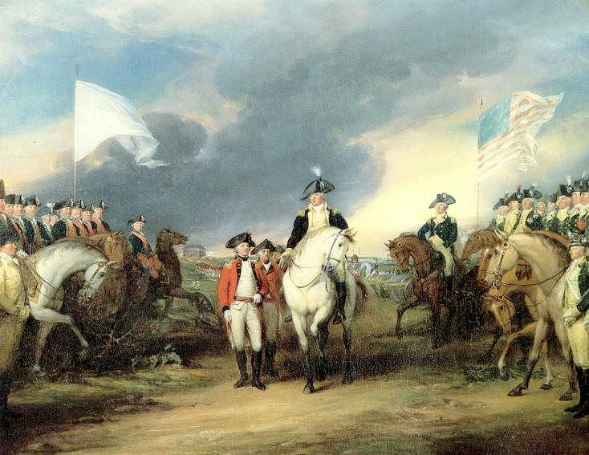
The American Revolution
Integrating E-Learning and Open Educational Resources into Classroom (iOERc)
ERASMUS + KD2 – Cooperation for Innovation and the Exchange of Good Practices. Strategic Partnerships for school education

Slide 2
Colonisation
England played a leading role in the colonisation of North America.
The gradual penetration along the Atlantic coast of the continent led to the formation of 13 colonies.

Slide 3
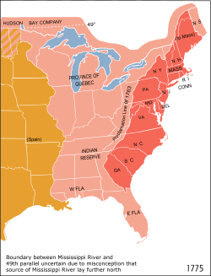
Description
The colonies were divided into 3 groups.
Northern colonies or the so-called “New England”.
Four middle colonies.
Five southern colonies.

Slide 4
Differences between the colonies
Government
Self-governed
Slave labour
Free farming
Religion
Anglican
Bastions of Puritanism
Governors
Catholic
Oligarchy
Profession

Slide 5
Extended dissatisfaction
The relationships between the colonists and the metropolis deteriorated further.
The English government was interested mainly in the collecting of taxes.
After 1767 new taxes were introduced . Among those new taxes was the so-called “Stamp Act”.

Slide 6
“No taxation without representation”
The Stamp Act met great resistance in the colonies.
George II was given a warning not to forget the fate of tyrants such as Charles I.
What London could not understand was that the colonists believed that they had the right to elect the government that would levy taxes on them.

Slide 7
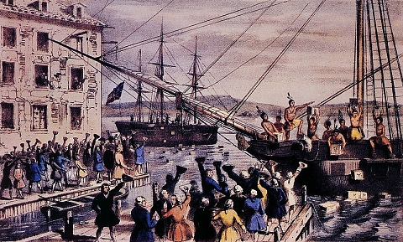
Единна съпротива на колониите
Искрата пламнала през 1773г., когато англичаните се опитали да наложат монополното право на Източноиндийската компания в търговията с чай.
Жителите на Бостън начело със Самюел Адамс нападнали английските търговски кораби в Бостънския залив и изхвърлили балите с чай в морето.
Boston Tea Party, 1773

Slide 8
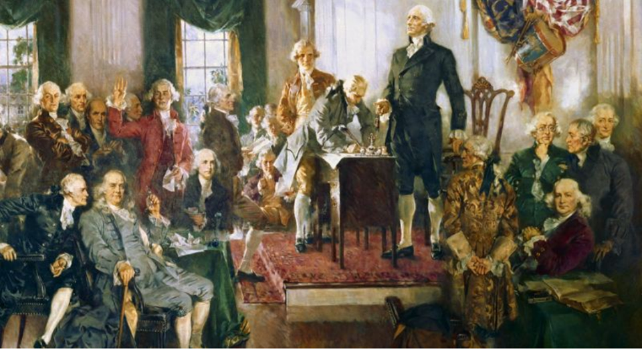
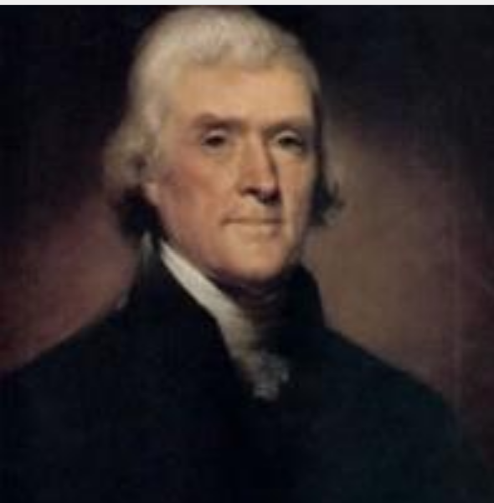
Independence war
The conflict started in Massachusetts. On April 18, 1775 there sounded the first shots which launched the War of American Independence.
On July 4, 1777 Second Continental Congress adopted the Declaration of Independence, written by Thomas Jefferson.

Slide 9
The colonists
The colonists no longer fighting just to protect their homes but the right to be independent.
It was created Continental Army. At the end of 1781 British troops capitulated.

Slide 10
New State
In 1783 he was signed the Paris Peace Treaty, which Americans received recognition of their country.
In 1787 in Philadelphia convened a constitutional convention called to work out the constitution of the new state.
Convent – Assembly of
constitution - the Basic Law, is run a country

Slide 11
Constitution
"Founding Fathers" (authors of the Constitution) believed that power should be divided into three:
- legislative - to pass laws
- executive - to monitor compliance with legislation
- judicial - to interpret the law and to resolve conflicts through a system of courts

Slide 12
These three types of government were divided between the three branches of government:
- Congress (parliament) passed a law
- The President was the head of the executive power
- The judiciary is interpreted by the Supreme Court
Mutual control of authorities strike a balance between them.

Slide 13
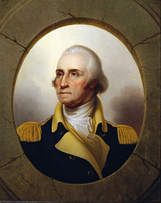
An example of mankind
Civil rights were guaranteed adoption in 1791.
Bill of Rights, which provided freedom of press, speech, assembly and religion, the inviolability of property, secrecy of correspondence and important right to trial by jury. First US president George Washington was elected.
In the young state was established republican model of government, which along with the separation of powers and guarantees of fundamental human rights became an example for the rest of humanity.

Slide 14
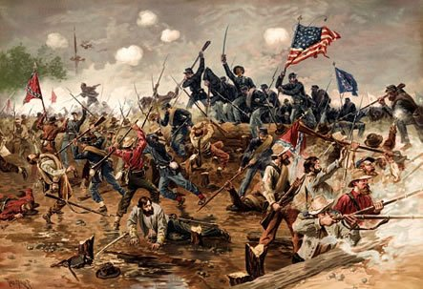
Thank you for your attention!

